Slide 1
Matrix Diagram
Nguyen Khanh Vy – 2152180
Tran Hoang Dat – 2152211
Huynh Tan Vinh - 2163083

Slide 2
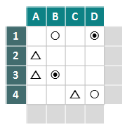
What is Matrix Diagram ?
A table that allows sets of data to be compared.
Displays the existence and strength of relationship between pairs of items of two or more sets.
The relationship is then indicated by a number or symbol in each cell where the two items intersect in the matrix.
A matrix diagram can be used as part of other decision making tools.

Slide 3
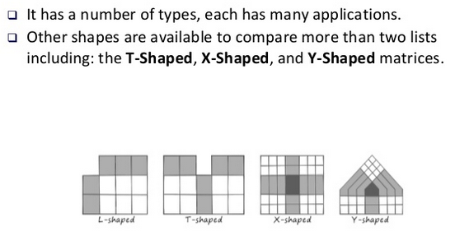
Types

Slide 4
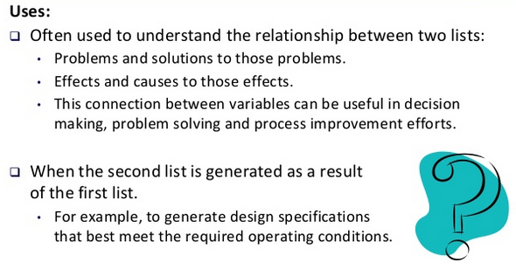
How to uses ?

Slide 5
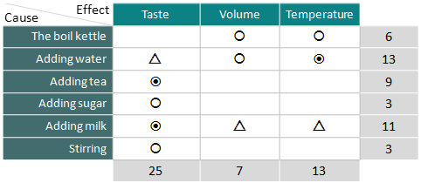
Example – How to Make a Better Cup of Tea:

Slide 6
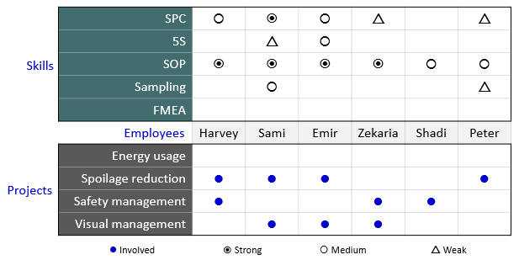
Example – Allocating Human Resources to Multiple Projects:

